Slide 1

Unit 4: HOME
Lesson 1.2
Page 53

Slide 2
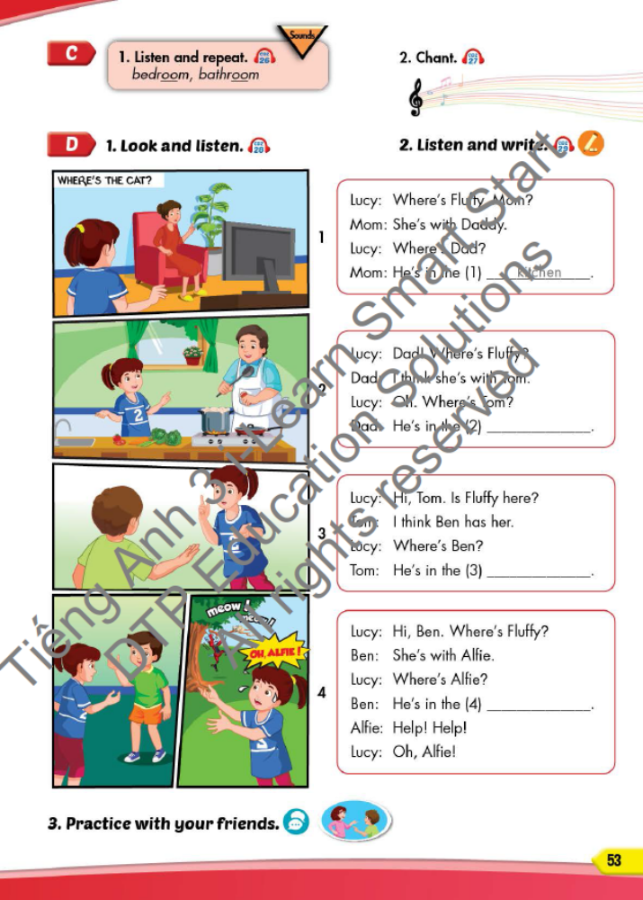
Lesson Outline
Warm-up
Listening
Consolidation
Wrap-up

Slide 3
Objectives
By the end of this lesson, students will be able to ask where people are.
Vocabulary: Revision
(bedroom, bathroom, kitchen, yard).
Structure: Where’s Dad? I think he’s in the kitchen.
Where’s Tom? He’s in the bedroom.
Help!

Slide 4

WARM UP

Slide 5
Unscramble the letters.
living room
1
l
v
i
r
o
m
o
i
g
n
bathroom
2
t
h
r
o
a
b
o
m
bedroom
3
b
e
r
d
m
o
o
r
kitchen
4
c
e
h
k
i
t
n
yard
5
a
r
y
d

Slide 6

It’s time to learn …

Slide 7


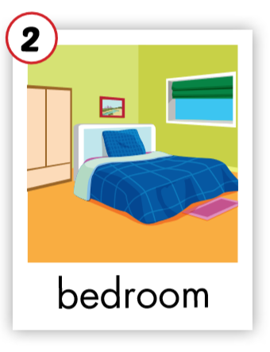
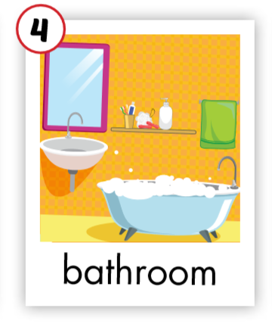
C. 1. Listen and repeat.
Click on the earphone/ each English word to hear the sound.
1
2

Slide 8


C. 2. Chant.
Click on the earphone to practice the chant.
/u:/ /u:/ /u:/
bedroom
bathroom
/u:/ /u:/ /u:/
/u:/ /u:/ /u:/

Slide 9

Listening

Slide 10

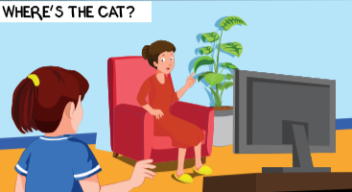
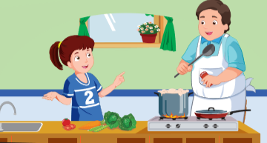
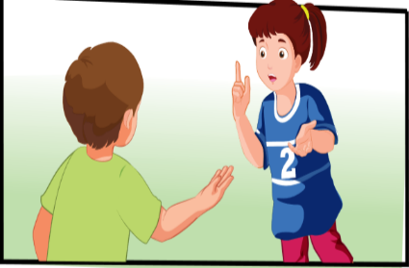
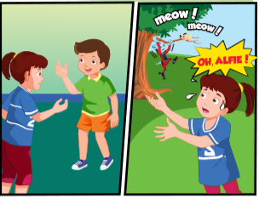
Click on the earphone to listen.

Slide 11



Click on the earphone or each sentence to listen.
Where’s Fluffy, Mom?
She’s with Daddy.
Where’s Dad?
He’s in the
kitchen.

Slide 12

Click the earphone or each sentence to listen.
Dad! Where’s Fluffy?
I think she’s with Tom.
Oh. Where’s Tom?
bedroom.
He’s in the

Slide 13


Click on the earphone or each sentence to listen.
Hi, Tom. Is Fluffy here?
I think Ben has her.
Where’s Ben?
bathroom.
He’s in the

Slide 14

Click the earphone or each sentence to listen.
Hi, Ben. Where’s Fluffy?
She’s with Alfie.
Where’s Alfie?
yard.
He’s in the
Oh, Alfie!
Help! Help!

Slide 15

Production
Production

Slide 16


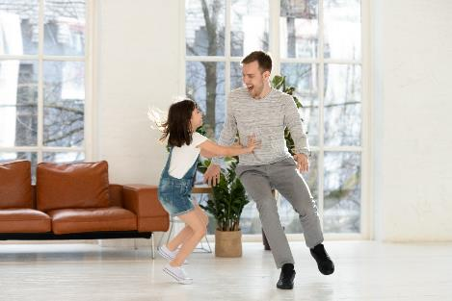
Where’s Trang, Mom?
She’s with Daddy.
Where’s Dad?
He’s in the living room.

Slide 17
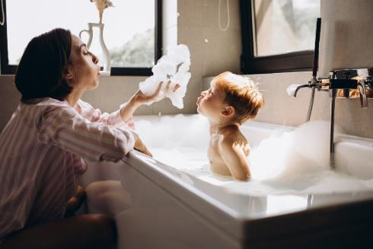
Where’s Tom?
He’s with mom.
Where’s Mom?
She’s in the bathroom.

Slide 18

Workbook
p. 39

Slide 19

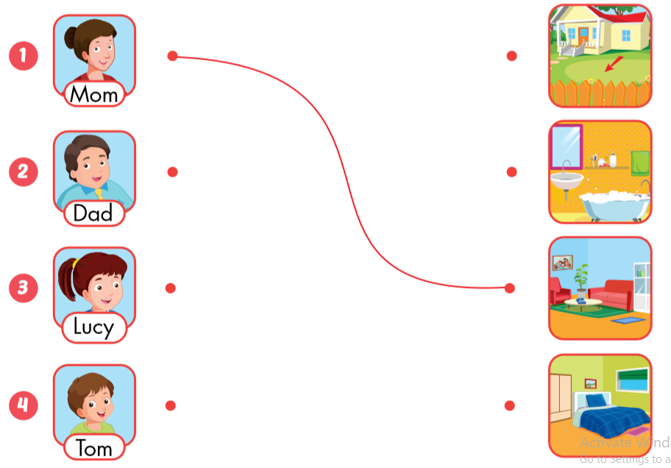

Slide 20



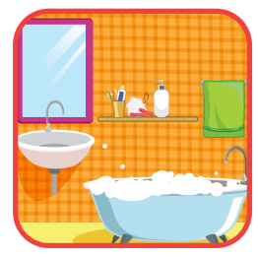
Mom’s in the living room.
Dad’s in the bathroom.

Slide 21


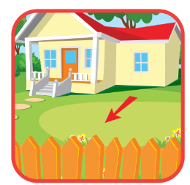

Lucy’s in the bedroom.
Tom’s in the yard.

Slide 22

CONSOLIDATION

Slide 23
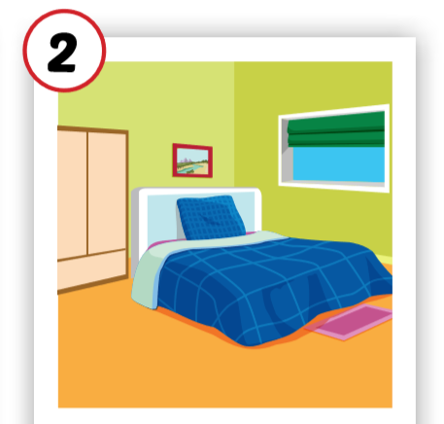

Where’s Tom?
He’s in the bedroom.
He’s with Nick.
bedroom

Slide 24
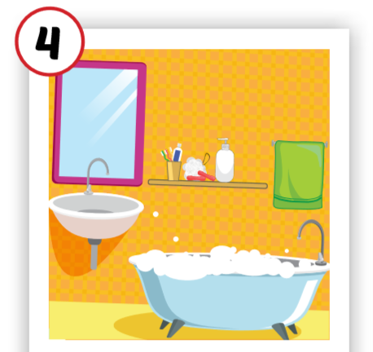

Where’s Lucy?
She’s in the bathroom.
bathroom

Slide 25
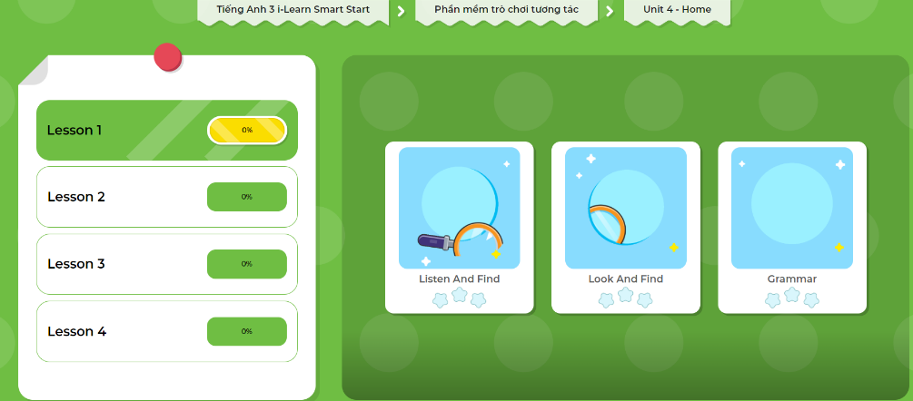
Extra Practice
DHA App
Let’s play!
Click here to play the game

Slide 26

WRAP-UP

Slide 27
Lesson 3
Today’s lesson
Vocabularies
bedroom
bathroom
Structures/ Sentence patterns
Where’s Fluffy?
She’s with Tom.
Where’s Alfie?
He’s in the yard.

Slide 28
Homework
Review the vocabularies and sentence patterns. Make sentences using them.
Do the exercises on page 39 (WB)
Prepare the next lesson (page 54 SB)
Play the consolidation games in Tiếng Anh 3 i-Learn Smart Start DHA App on www.eduhome.com.vn

Slide 29

Enjoy your day!

Slide 30

Have a nice day!

